Slide 1

Election System in Sri Lanka
Team Semicolon

Slide 2
Problems
Traditional voting system doesn't have strong security.
Delivery Mechanism
Delivering election boxes
Some people doing mistakes while they are voting.
Some people add fake votes.
Takes some time to calculate persons votes.
Low confidently
Sometime not accurate collection of votes and average.
Taking lot of time to delivery election boxes.
Notes:
Sri Lanka, being the oldest democracy in South Asia, is still using an old traditional paper-based election system. There are many problems with that method.
Security is a must thing to consider in an election system, but the traditional voting system doesn't have strong security.
Delivery Mechanism: In the traditional voting system, there are collected election cards in a box. And after the election the boxes delivery started.
There are some problems in delivering election boxes.
Some people make mistakes while they are voting.
Some people add fake votes.
takes some time to calculate a person's votes.
low confidently.
sometimes not an accurate collection of votes and average.
take a lot of time to deliver election boxes.

Slide 3

Fingerprint
Voting
System
Notes:
Solution
The proposed system is introduced with a unique computerized application for the Sri Lankan election system instead of the traditional paper-based system. It is a web-based application. Voters can easily cast their votes through this system. According to the current system of voting in Sri Lanka, there are two ways in which one voter can give one or three preferences. The system is capable of handling both of these methods. The entire system is administered by an administrator and the administration of the polling station is administered by the polling center inspector. The system uses fingerprints to identify the voter. This system includes a non-fingerprint system for disabled voters who cannot provide a fingerprint. That system is handled by a polling center inspector Once a voter inserts his fingerprint into the system, he is allowed to vote only if it is valid. Once a voter has cast a vote, this system automatically deposits that preference data system after decoding. This system can reduce the number of valid votes and reduce time the counting of votes.

Slide 4
Benefits
This system can reduce time the counting of votes
No delivery mechanisms.
No fake votes.
High confidently
Strong security than traditional system.
Voting can be done at any polling station
After verification, it will automatically reload the page in the preferred language of the voters.

Slide 5
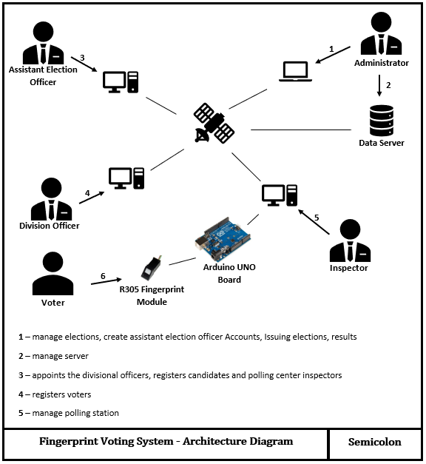
Technical Design

Slide 6
Thank You!
Team Semicolon

